Slide 1
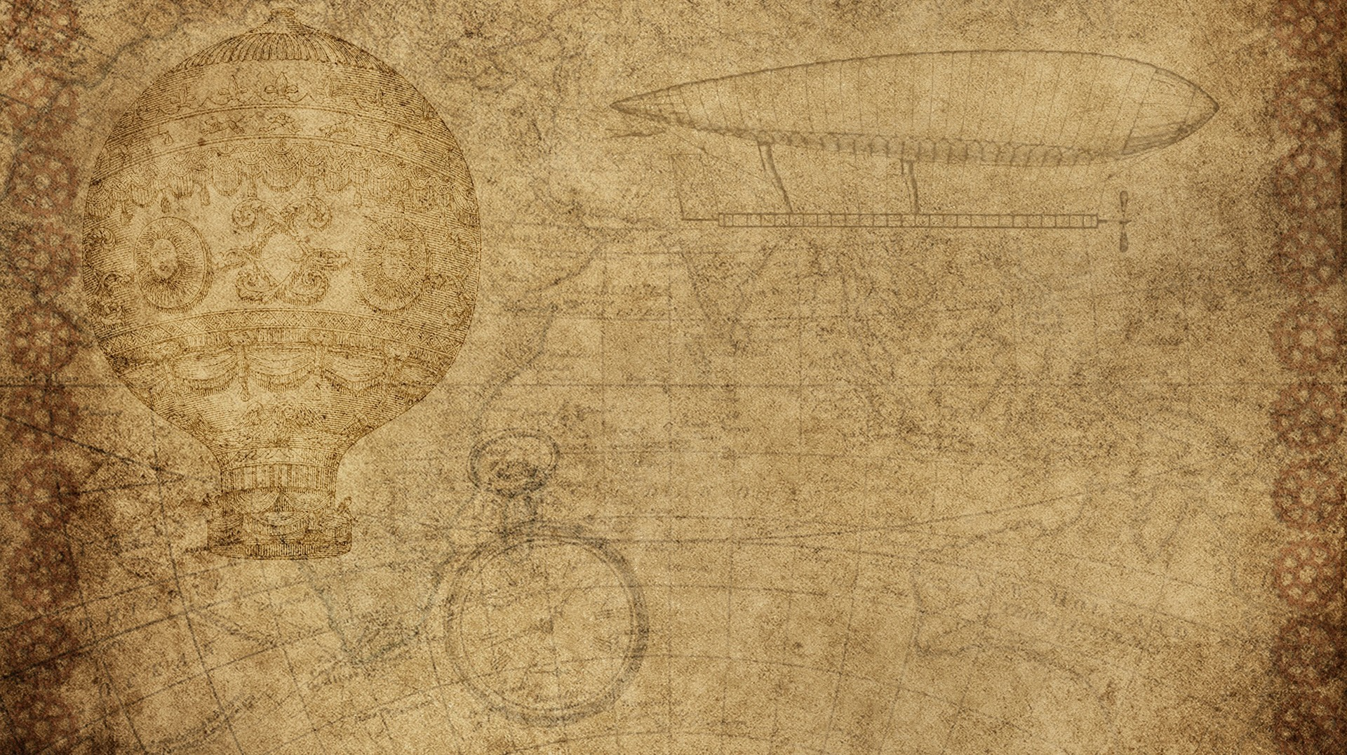


The Snake which bites
Python and pygame

Slide 2

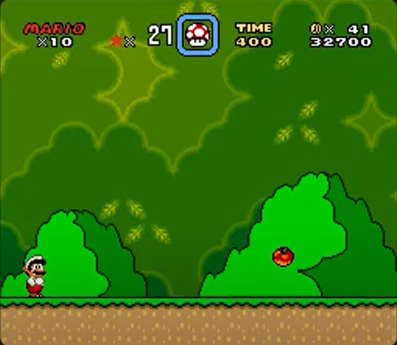
How games work in general
Given here is a level 1 Mario screen
It is composed of several components
First the background
Then the bushes and apple
Mario himself
Some indicators at the top
Each of these elements are just images which we can download and use for ourself

Slide 3
How games work in general
The important thing to note is that this image is not just drawn once instead it is drawn multiple times per second in what is called a game loop and then to turn this into a game we have to add two more things
Player input so that you have to know what the player wants to do
On each cycle you also reposition where elements are supposed to be drawn
In total there are 3 steps
Check player input
position elements on screen accordingly
then draw all the elements
And if that happens often enough you get a video game

Slide 4
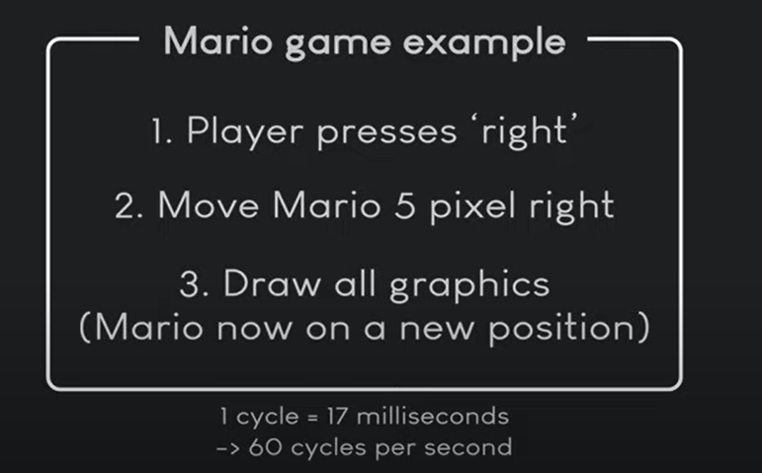
The basic construct
As a consequence the player is perceiving all of this as an interactive medium

Slide 5
In an actual game much more is happening than just moving a player to the right
So for example, Mario if he is moving to the right we also want to play a walking animation which further adds to the illusion that Mario is walking instead of just being repositioned on the screen. We could also move around enemies , give the player power ups ,add some coins, timers or really anything that would constitute parts of a game
And if you understand that logic you can make a game in basically anything as long as you can get these free elements and this could even be a game

Slide 6
Basics of pygame in code

Slide 7
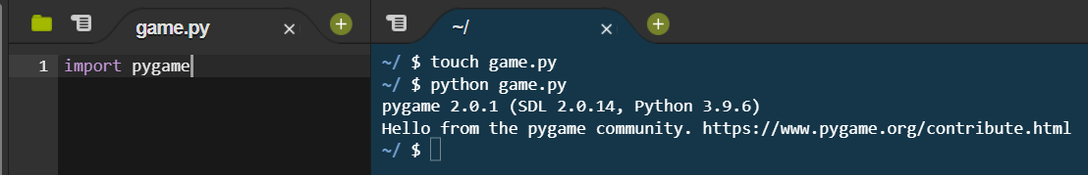
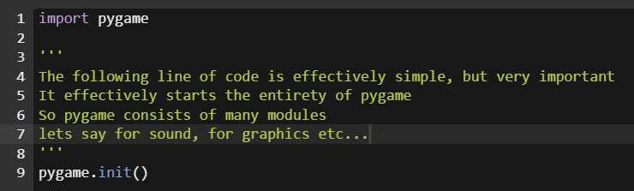
The code above doesn’t do much, so lets add our very first spring
But on running this you will get the same output as above, so lets add some more lines of code

Slide 8
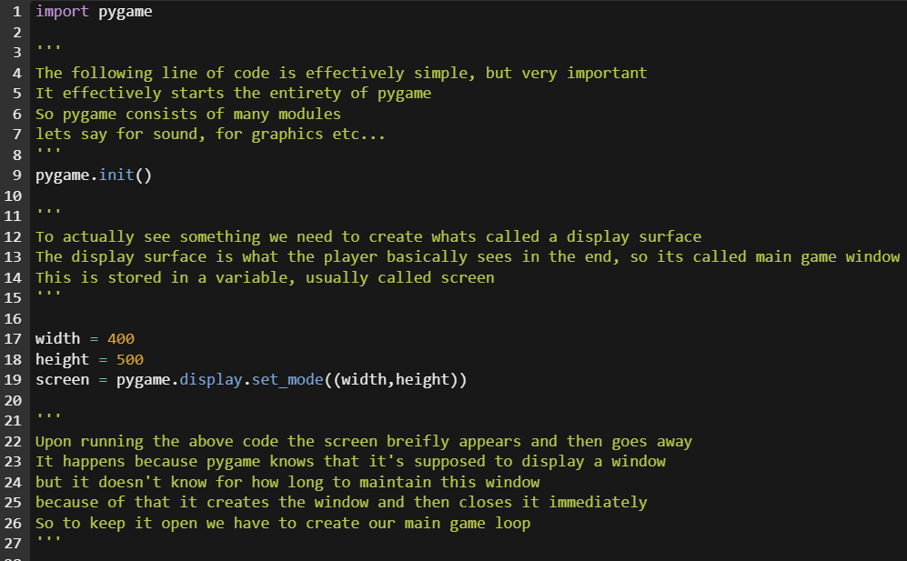

Slide 9
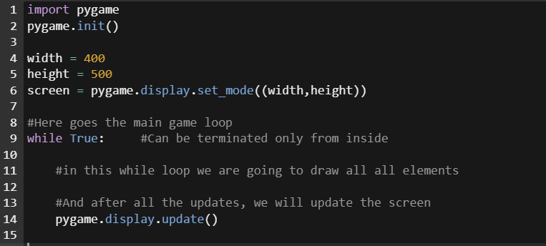
The above code works well, but it is not recommended to run it as it would not terminate, since we haven’t actually implemented the terminate function just yet
To do that we need an event loop

Slide 10
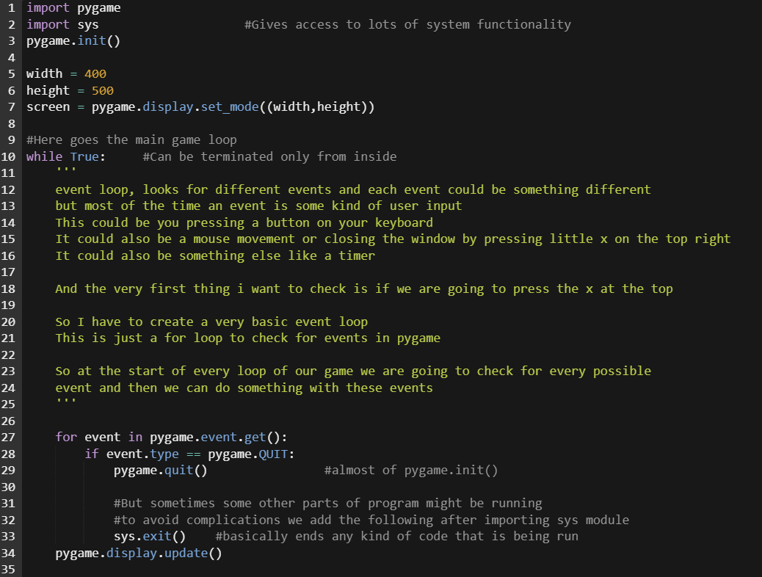
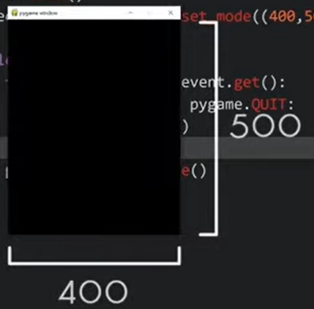
Now lets run our code

Slide 11
Few more Basic setup terminology
Our game loop will run as fast as our computer can run it, and this could be a problem as on different computers the came could be serving different experiences to the user
The game could also run differently on the same computer depending on the number of operations that is to be performed at different points of the game
So to maintain consistency, we need to make sure our game doesn’t exceed a certain maximum frame rate. To achieve this, we create a clock object that limits how fast our while loop can run
The implementation in code is shown in the next slide

Slide 12
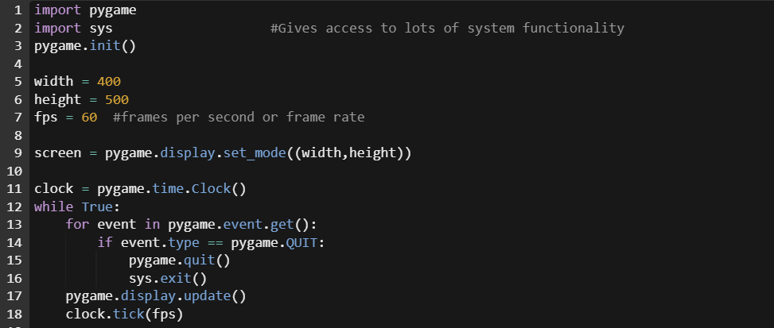
We might also face an issue sometimes that a game is running too slow, there is no natural fix for it though, it depends on how efficient you code your game and make sure the game works at a fine frame speed

Slide 13
What we have till now?
A basic game screen that has a specified maximum frame rate, which closes on pressing the little x mark on top right
What next…?

Slide 14
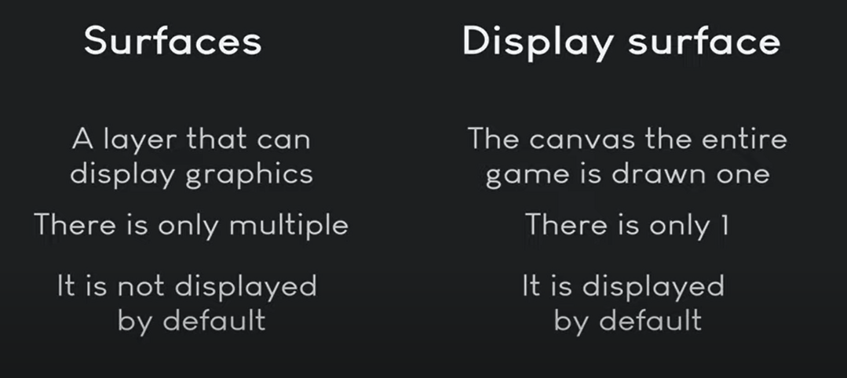
Drawing shapes in pygame
To really understand pygame, we need to understand two basic concepts
Surfaces
Rectangles
Lets start with surfaces, but earlier we learnt about display surface right? What was that??

Slide 15
Using a surface
Create a surface by
Import image
Write a text
Or just create an empty surface(Will be entirely black by default)
Put the surface on the screen, ie take the surface and put it on the target surface where you want it to be, in our case it is going to be the display surface, although we can put a surface on top of other surface
Lets try to use surfaces in our code to understand them a little

Slide 16
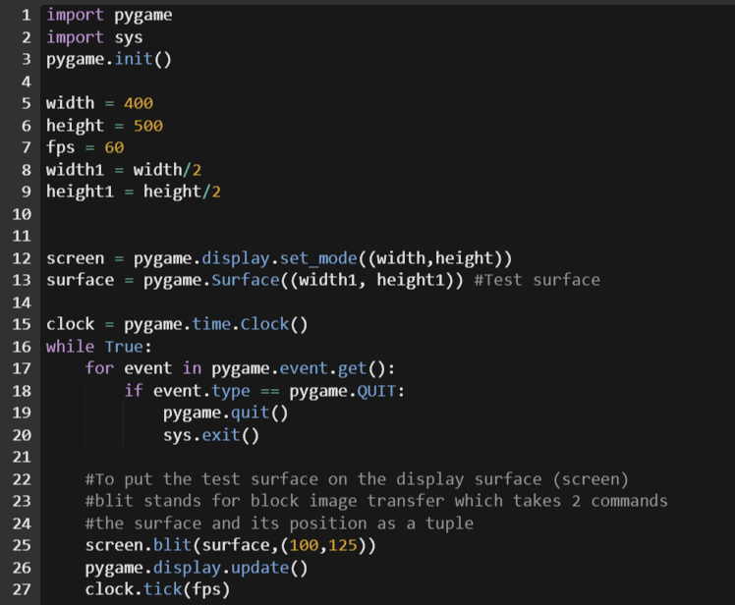
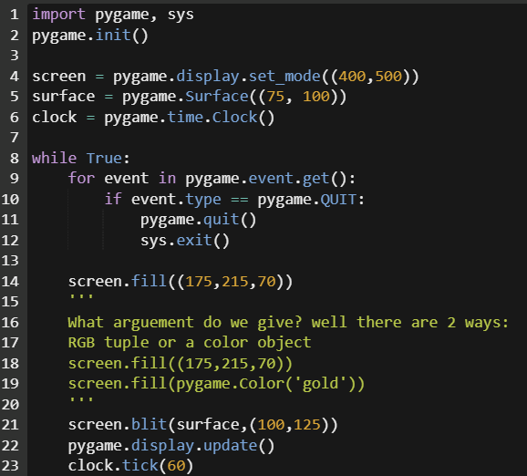
On running the beside code you will get a blank screen because both the display surface and test surface are empty == both are black
So I fill the display surface with some color using the following code

Slide 17
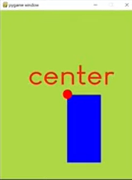

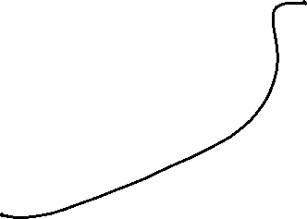
Positioning in pygame

Slide 18
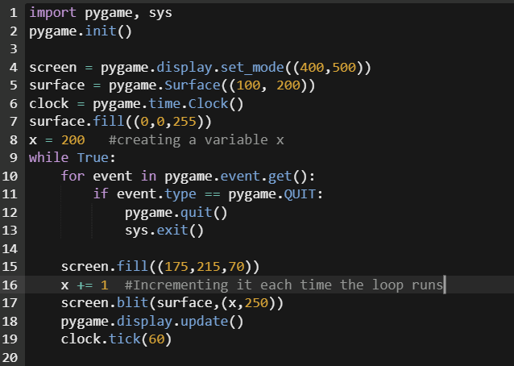
Making things dynamic
So far our code produces only a static screen, lets try to add some dynamism in it, to do that, ill make the test_screen move by making the following modification
On running the code, we feel that the test surface is going right, but its just shifting positions in short time
This is similar to the motion picture logic

Slide 19
Rectangle/rect
We didn't really have all that much control about how to place the test surface, So for example if we wanted to place the center of the surface we couldn't really do it or let's say if we wanted to place the bottom right we just couldn't really do it.
To fix that pygame has another concept that is called a rectangle
Well a rect is just a rectangle that you can either put around something else or use for drawing
The rectangle has a lots of different points that we can influence which are shown in the next slide

Slide 20
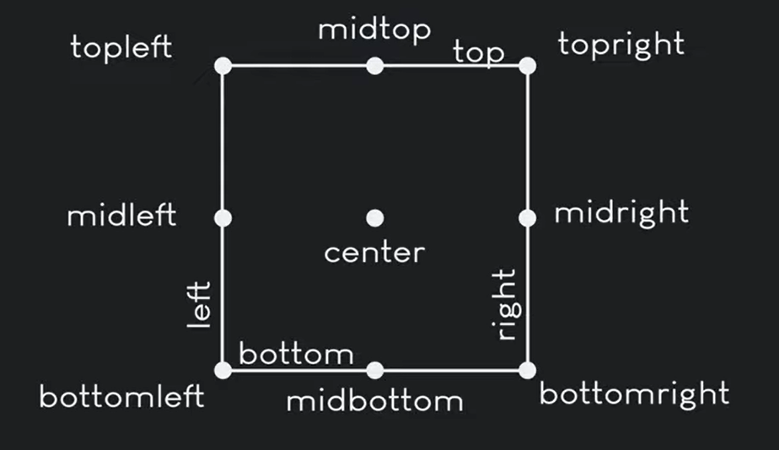
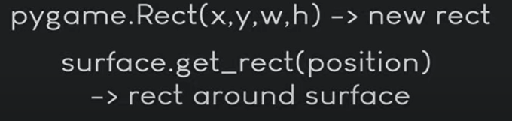
The points are super useful not just for moving, but also to check overlapping with other elements, or if something is moving out of screen, or to measure how large an element is.
There are 2 ways to create a rectangle
To create a rectangle by itself
Take a existing surface and wrap it with a rectangle

Slide 21
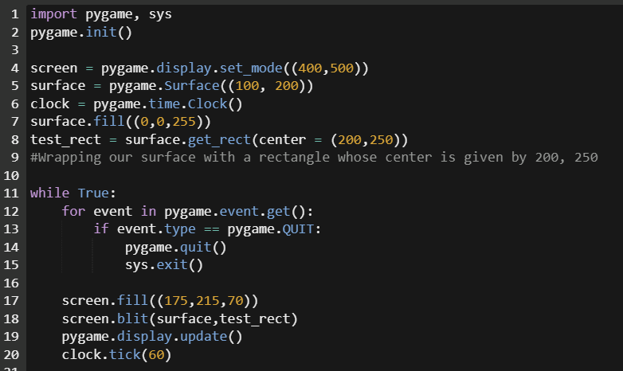

Slide 22
Logic of the snake
Two main logics
Effectively creating a grid on our display but we are not really creating a grid, we are just simulating it and instead what we are going to do is that every time we are moving we can only move in certain increments let's say by the amount of 40 pixels and since you can only move by that amount, you are effectively moving in a grid although it's not really a grid
And into this grid we are going to put our snake and that's going to be the second major concept and effectively our snack is going to be a list with different positions and each of these positions is a block and all we are going to do to move the snake is to update each of the block in a certain direction and then we are drawing the block and that gives us a snake

Slide 23
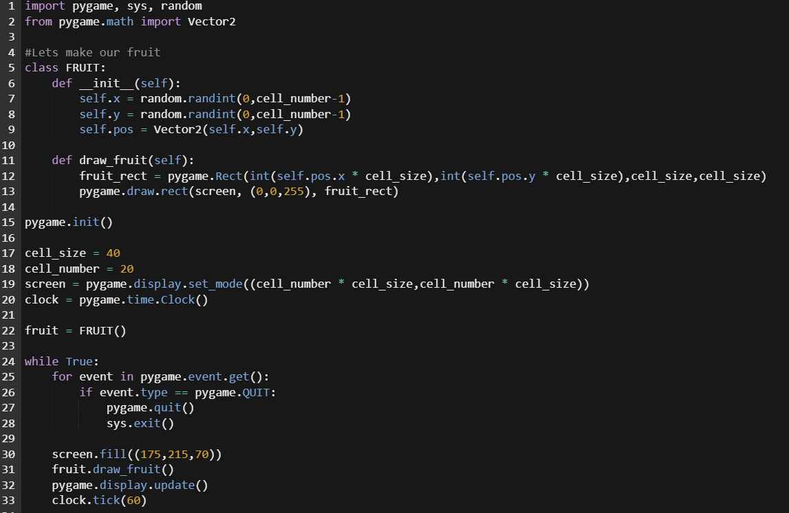
Setting up the board and fruit

Slide 24
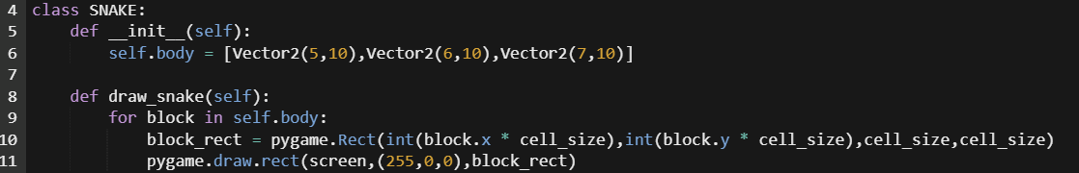
Creating the snake

Slide 25
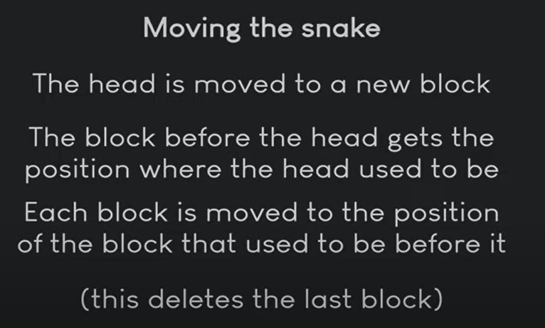

Slide 26
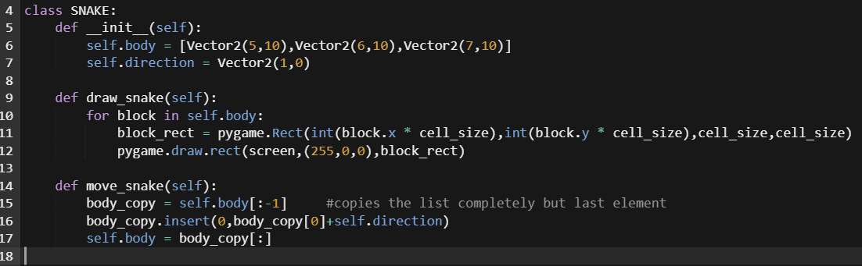


Slide 27
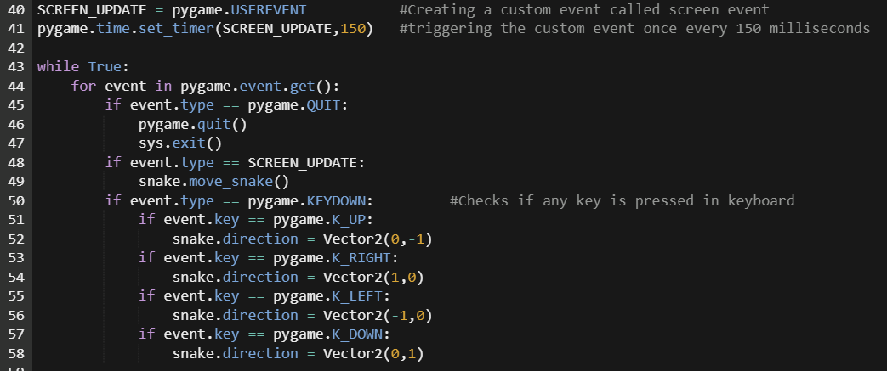

Slide 28
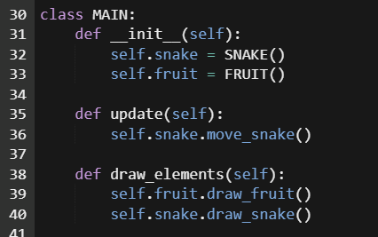
Let the snake munch
We now create a new class called main which will contain the entire game logic and the snake and fruit object and then make changes to the entire code accordingly.
As the fruit and snake are in the same class now, it is easier to check where they are in relation to each other
So to the main I add a new member called collision which deals with collision between snake and fruit as shown in the next slide

Slide 29
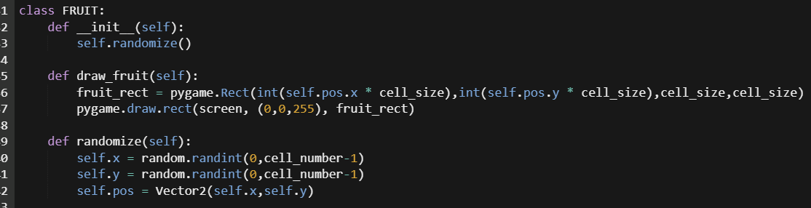
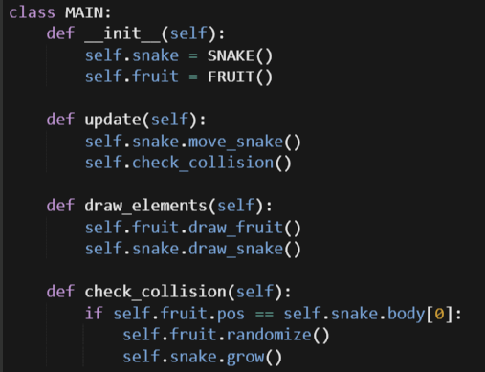
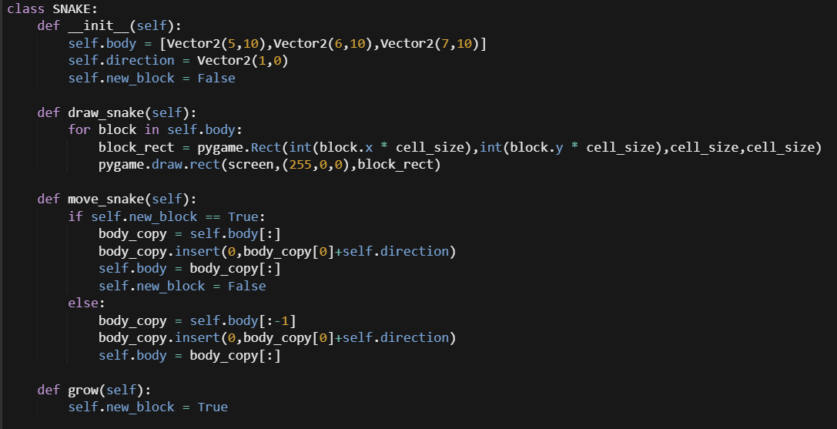

Slide 30
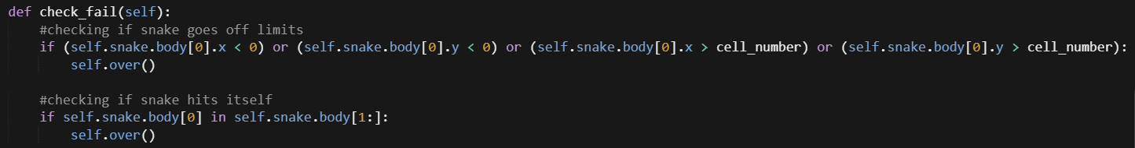
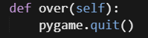
Hitting the wall or itself
To do that we add an other member in the main class as shown and add it to update member

Slide 31
Drawing the fruit
First, ill import the image
\
Also we modify he fruit class as

Slide 32
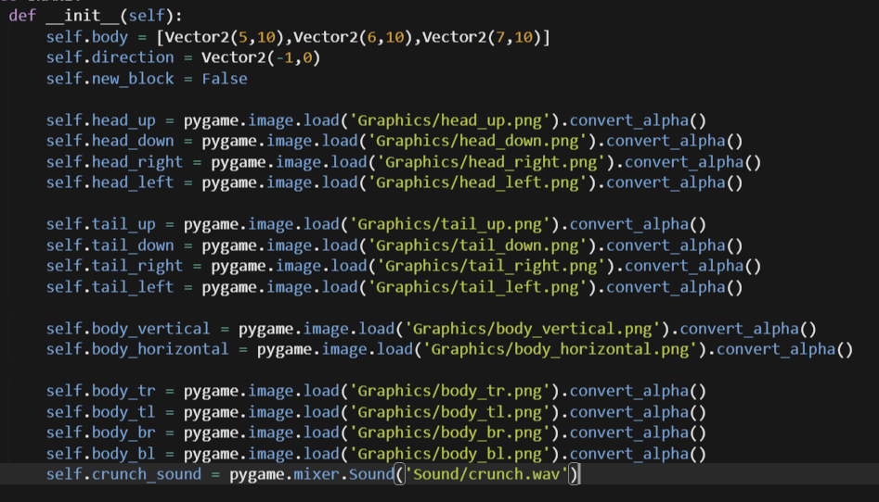
Graphics to the snake
First load the necessary images in the snake constructor(As they are needed for snake)

Slide 33
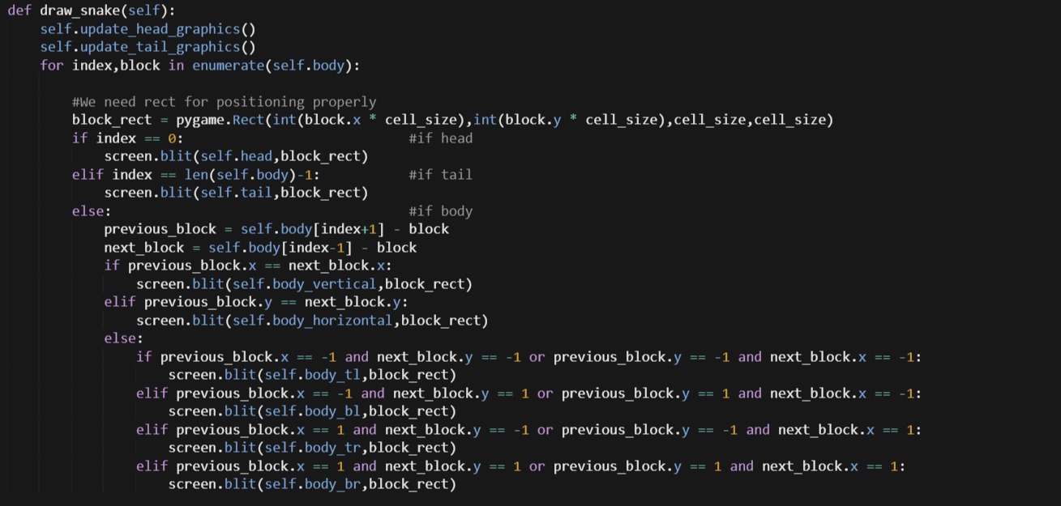
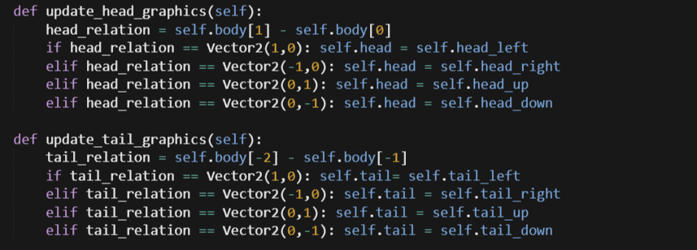

Slide 34
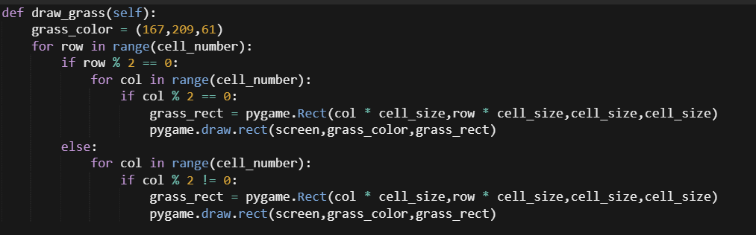
Make the background better
Lets add a new member function in main to draw grass

Slide 35
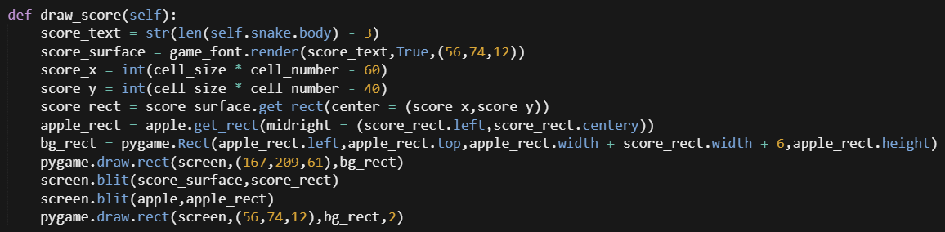
Add Score
Now in pygame to add text
Create a font object
Create text with the font object
Blit the text on display surface

Slide 36
Add sound

Slide 37
Final touch up

